Slide 1
Placeholder

Slide 2
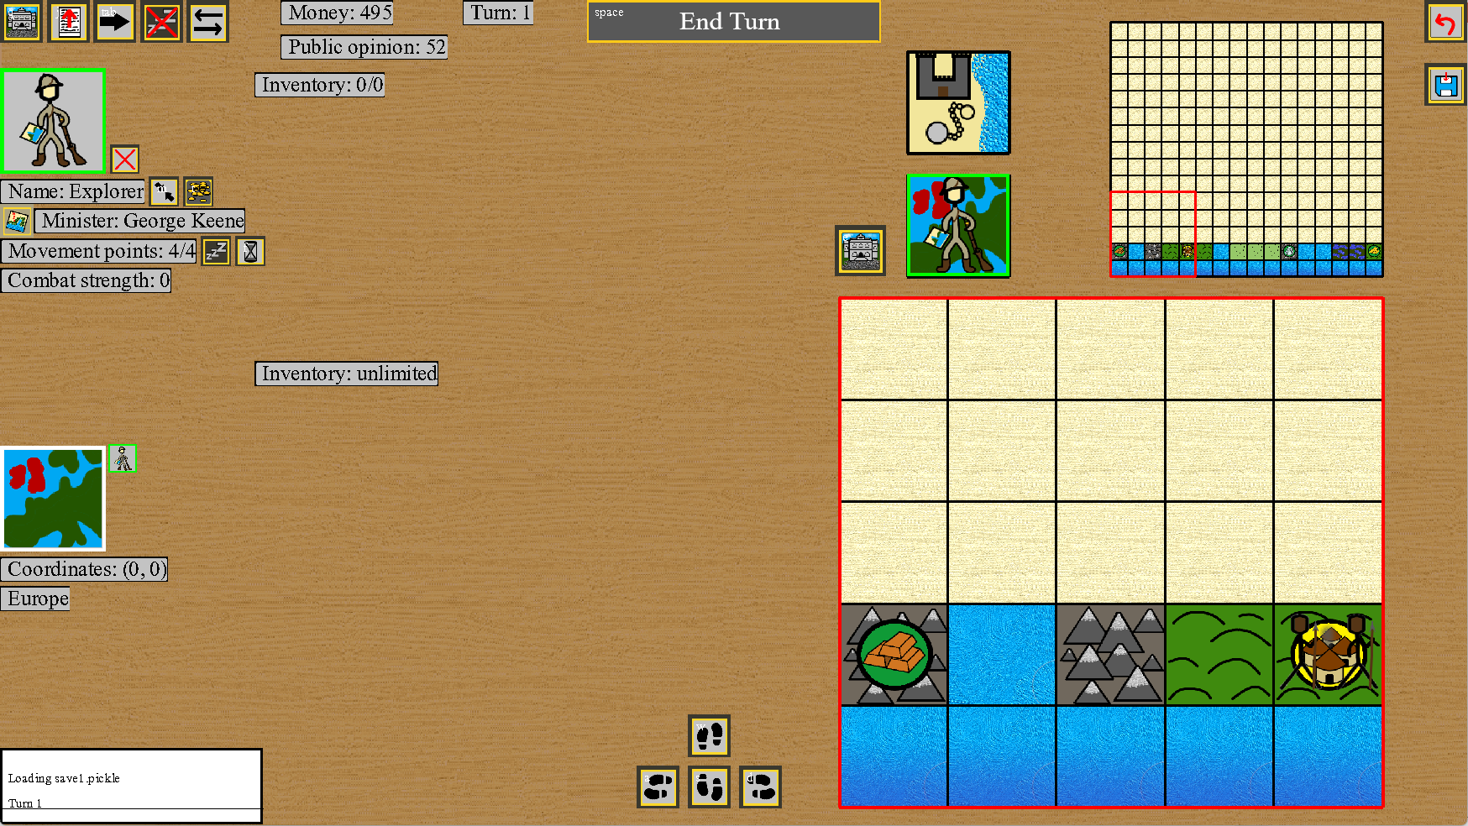
SFA Strategic Interface Screenshot

Slide 3
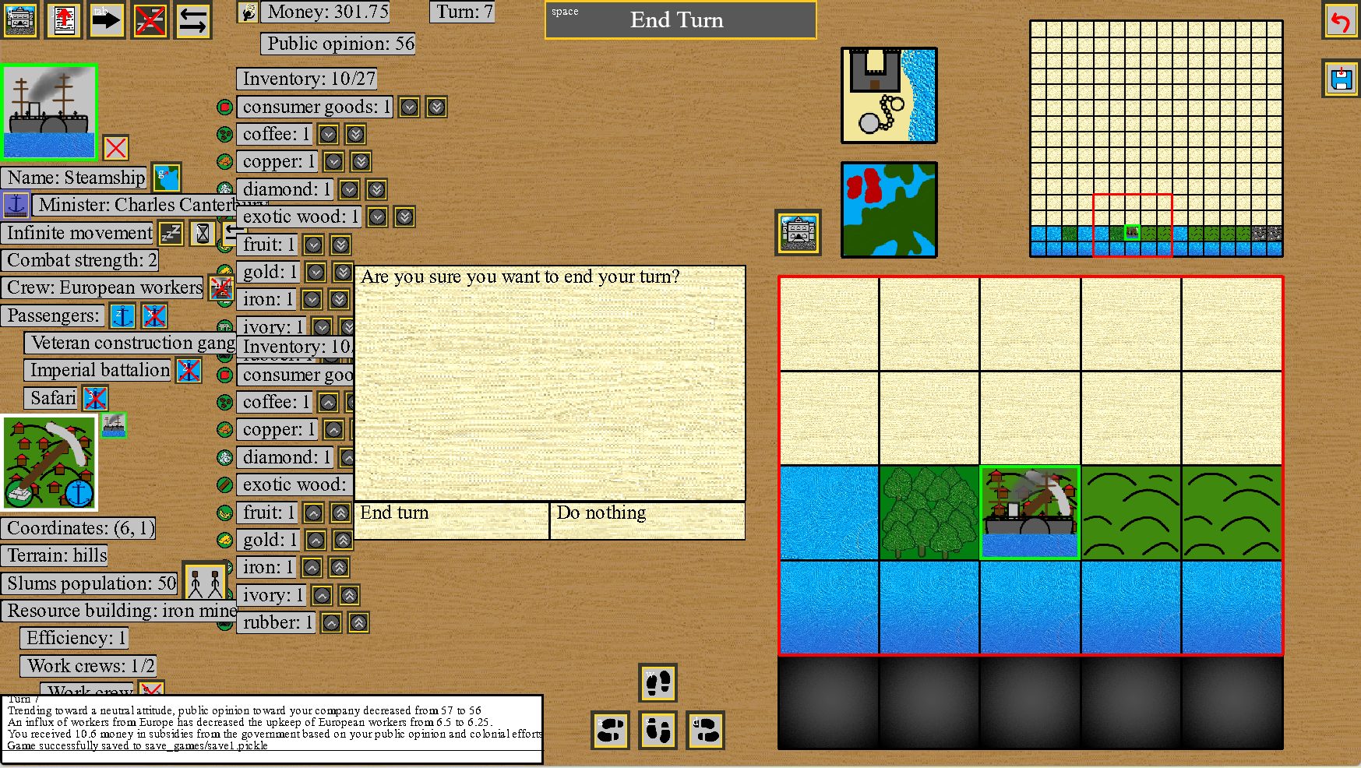
SFA Strategic Interface Maximum Clutter Screenshot

Slide 4

Misc. Buttons
General Global Stats
End Turn Button
Strategic Map Grid
Slave Traders Grid
Unit Icon
Unit Inventory
Name
Unit buttons
Europe Grid
Minister
Movement
Combat Strength
Notification
Misc. Unit Info
Minimap Grid
Tile Inventory
Tile Icon
Coordinates
Terrain
Choice 1
Choice 2
Misc. Tile Info
Movement Buttons
Text Output Box
SFA Strategic Interface Layout
Shown by default
Shown conditionally

Slide 5

Misc. Buttons
General Global Stats
End Turn Button
Strategic Map Grid
Slave Traders Grid
Unit Icon
Unit Inventory
Name
Unit buttons
Europe Grid
Minister
Movement
Combat Strength
Notification
Misc. Unit Info
Minimap Grid
Tile Inventory
Tile Icon
Coordinates
Terrain
Choice 1
Choice 2
Misc. Tile Info
Movement Buttons
Text Output Box
Second Earth Strategic Interface Layout
Shown by default
Shown conditionally

Slide 6
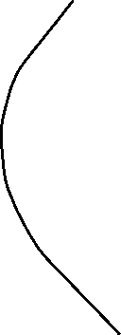
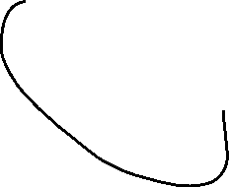
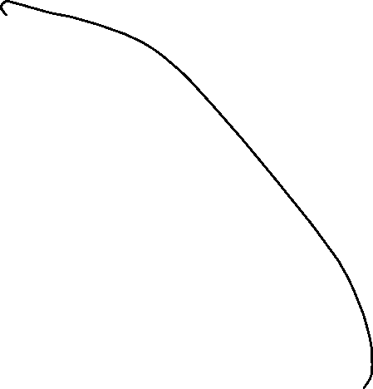
Spherical Planet Idea

Slide 7


Spherical Planet Idea

Slide 8
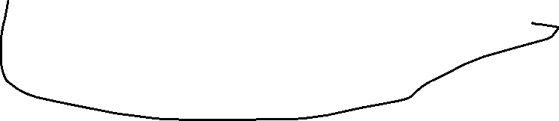

Spherical Planet Idea

